Slide 1

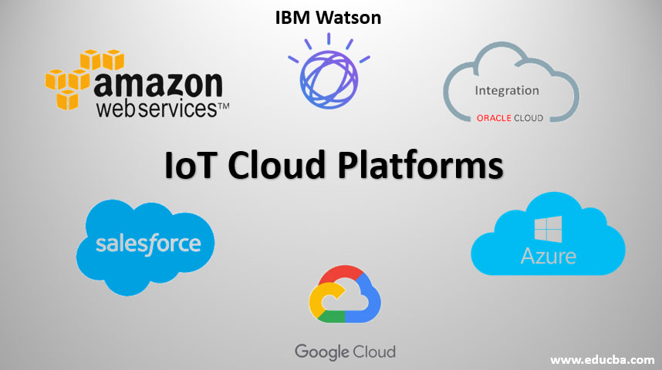
CLOUD COMPUTING
1. Why Cloud Computing?
2. What is Cloud Computing?
3. What are Cloud Services?
4. Types of Cloud Providers
5. Cloud Computing Service Models: IaaS, PaaS, SaaS
6. Azure Cloud

Slide 2
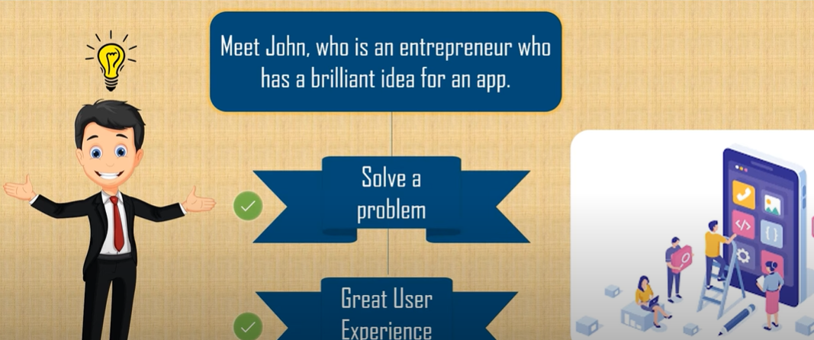
Why Cloud Computing?

Slide 3
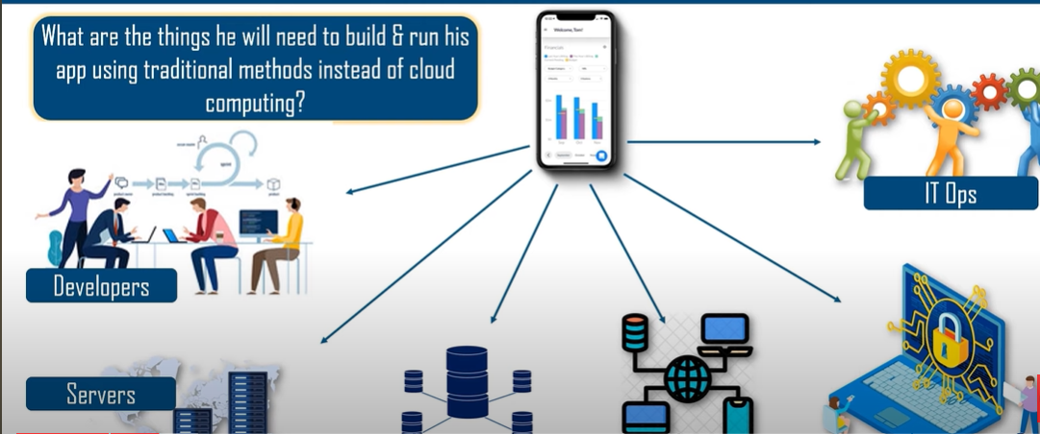
Why Cloud Computing?
Storage Devices
Network
Security Systems

Slide 4
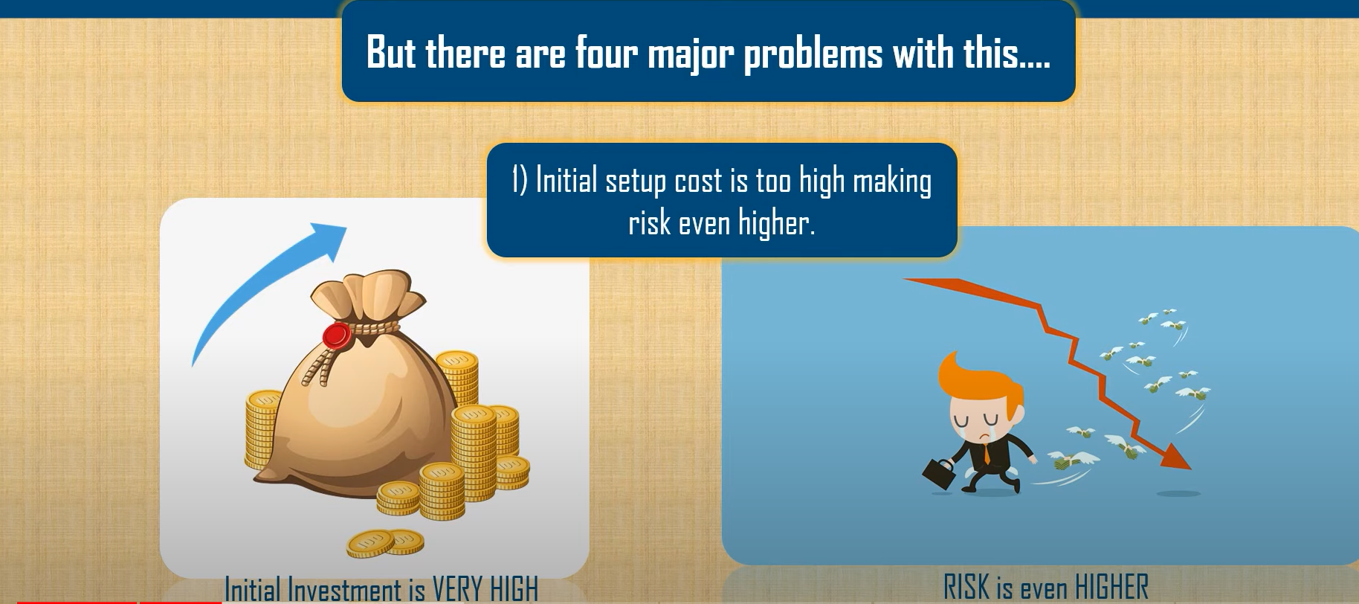
Why Cloud Computing?

Slide 5
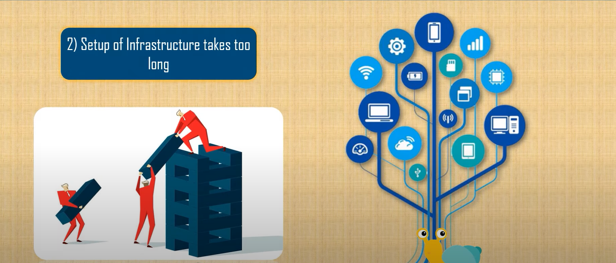
Why Cloud Computing?

Slide 6
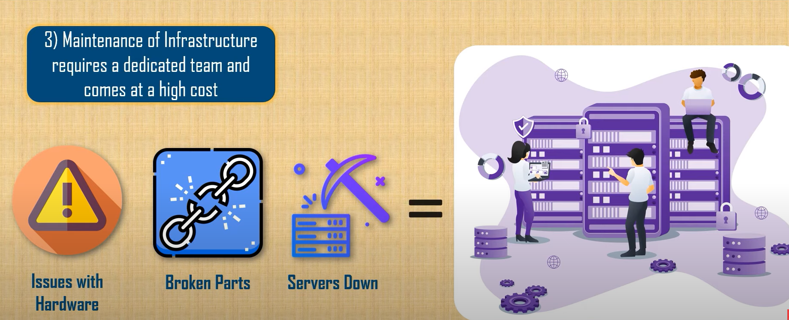
Why Cloud Computing?
Dedicated Team

Slide 7
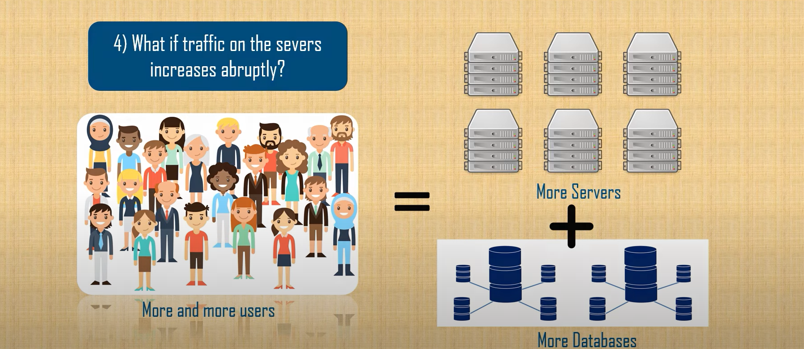
Why Cloud Computing?

Slide 8
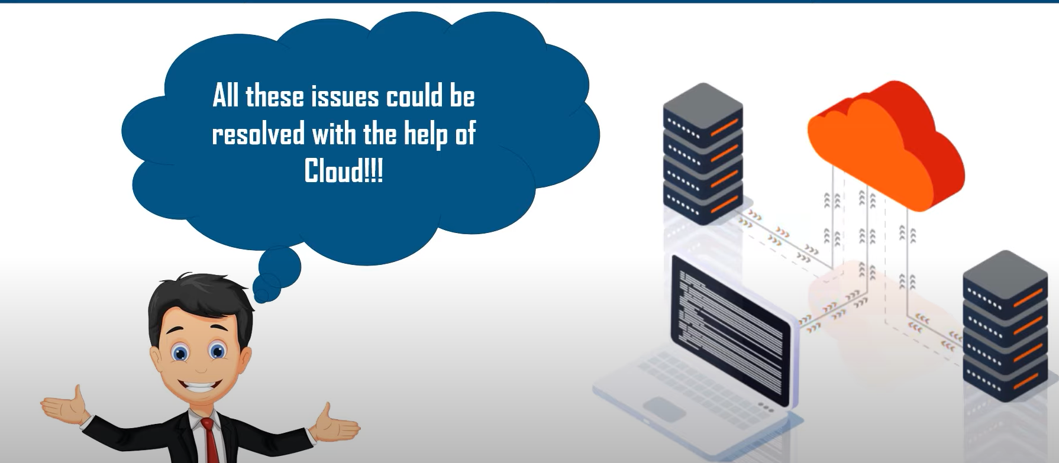
Why Cloud Computing?

Slide 9
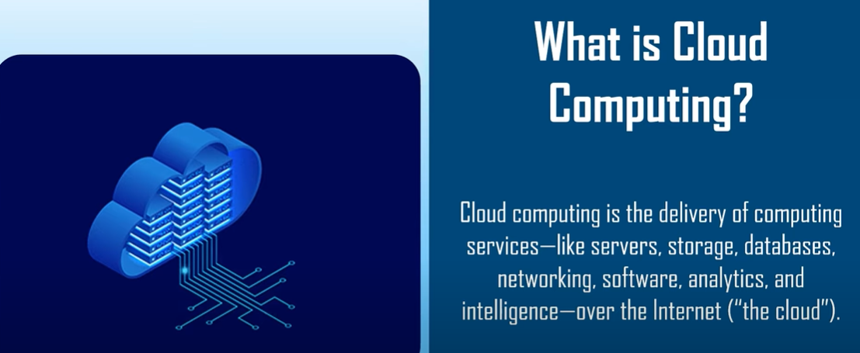
What is Cloud Computing?

Slide 10
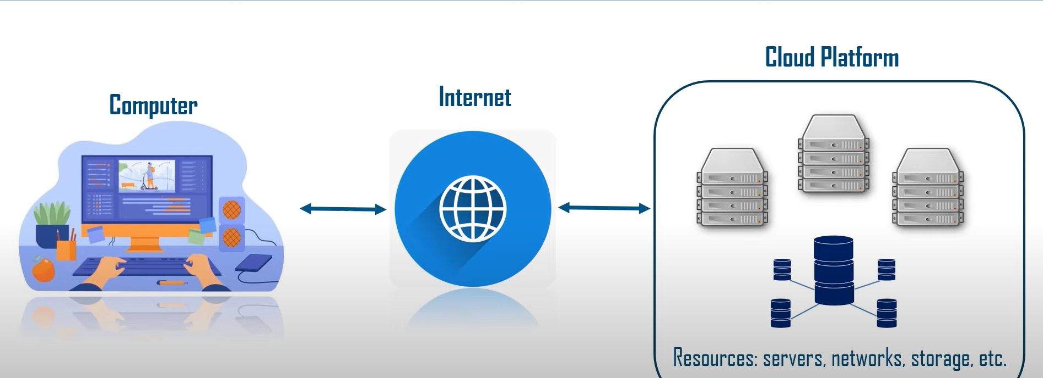
What is Cloud Computing?

Slide 11
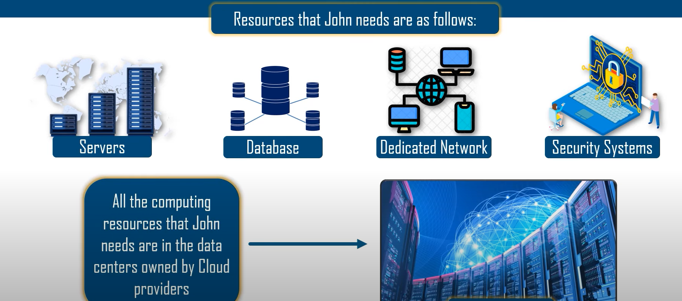
What is Cloud Computing?
Physical Machines

Slide 12
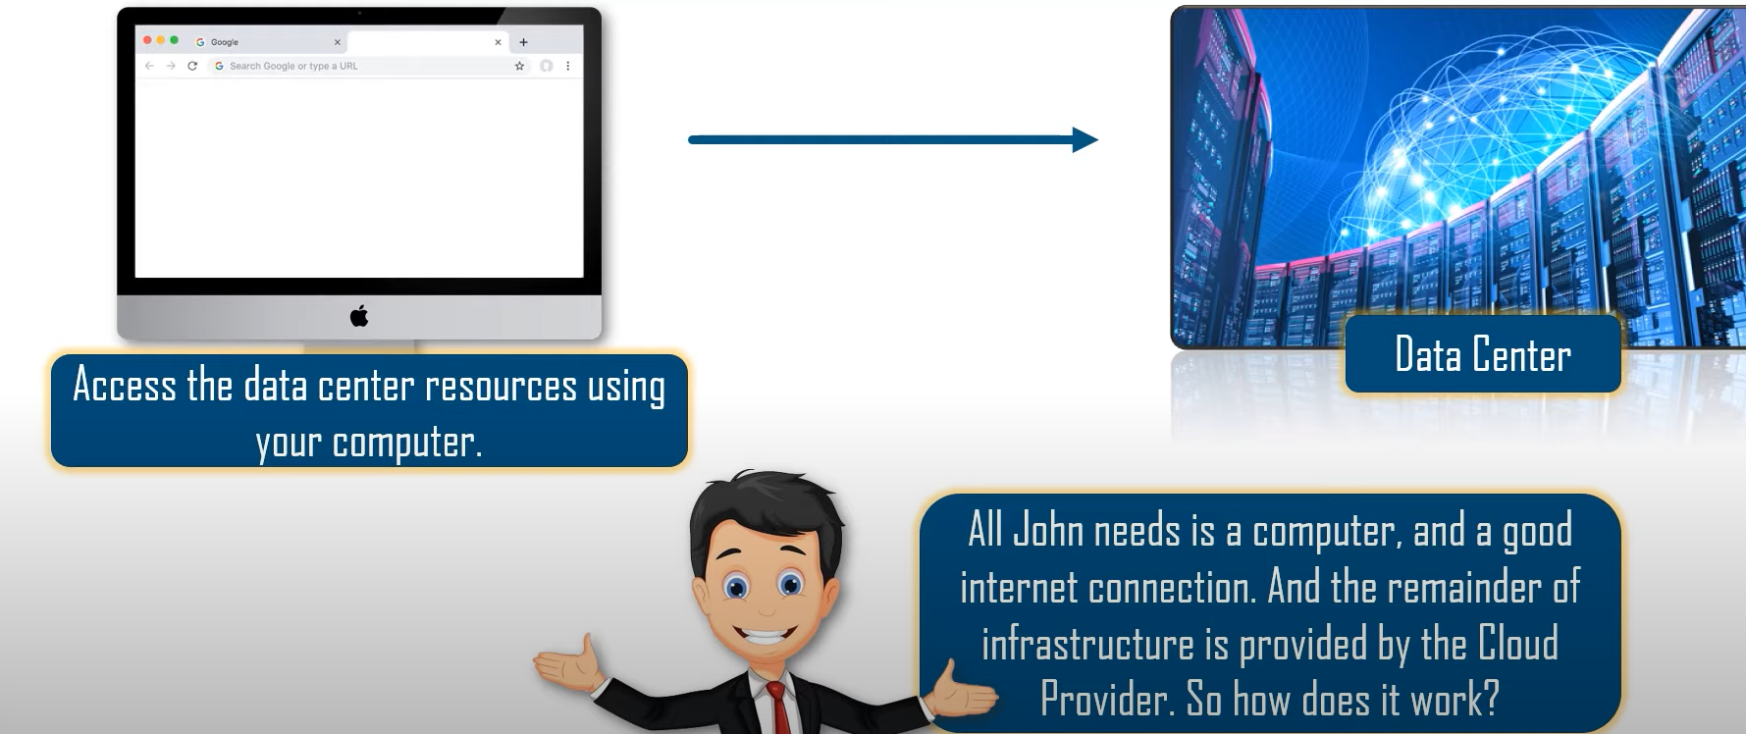
What is Cloud Computing?

Slide 13
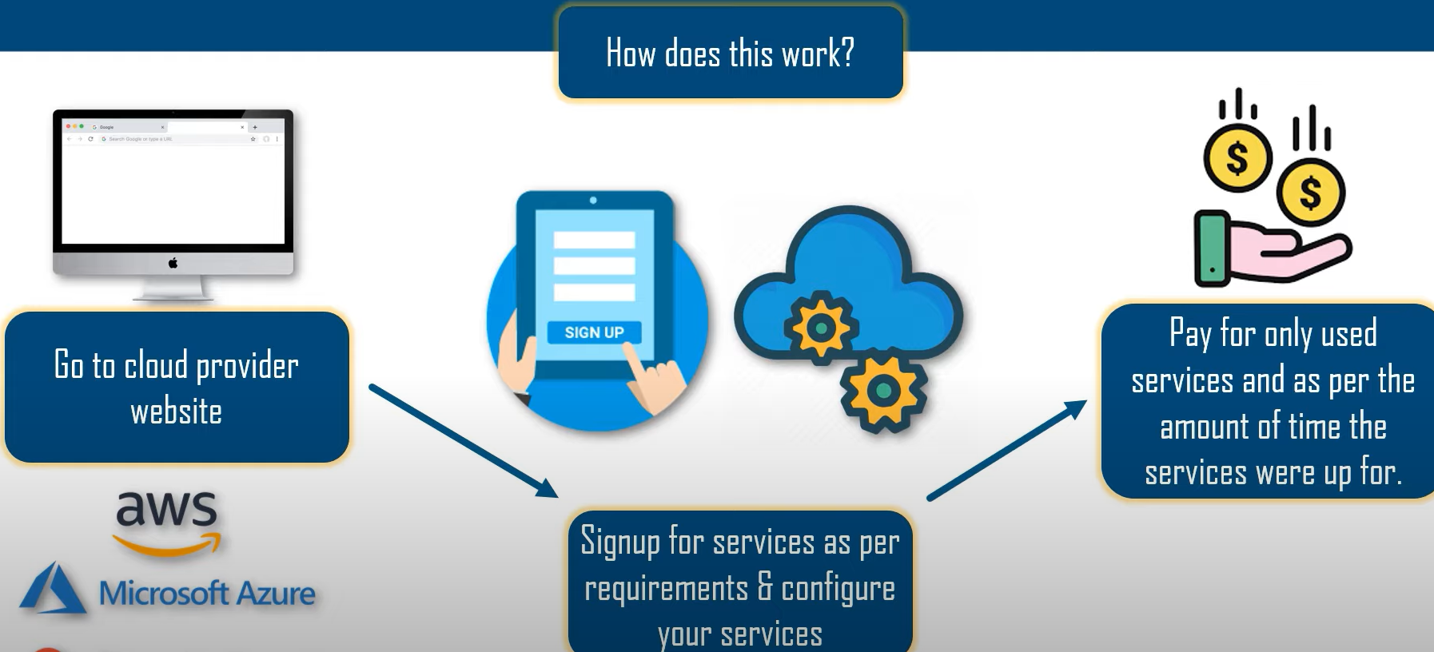

What is Cloud Computing?

Slide 14
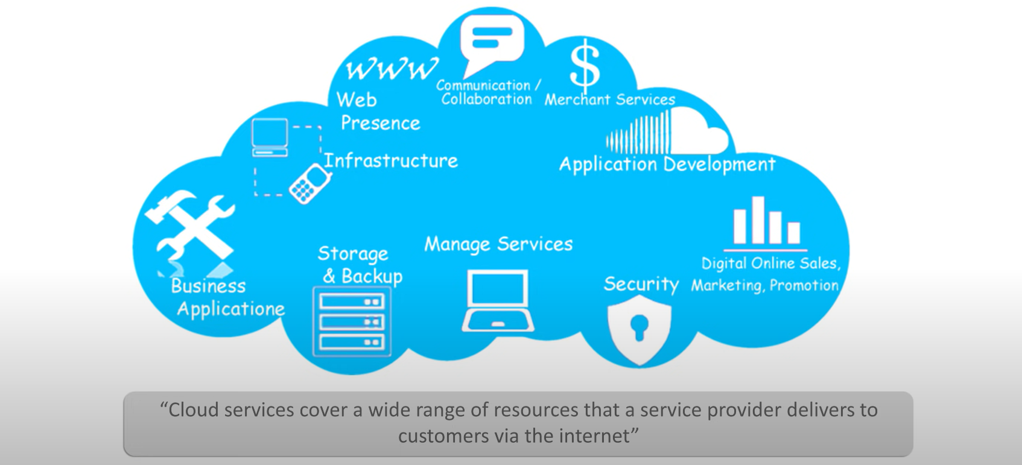
What is a Cloud Service?

Slide 15
Types of Cloud Providers

Slide 16
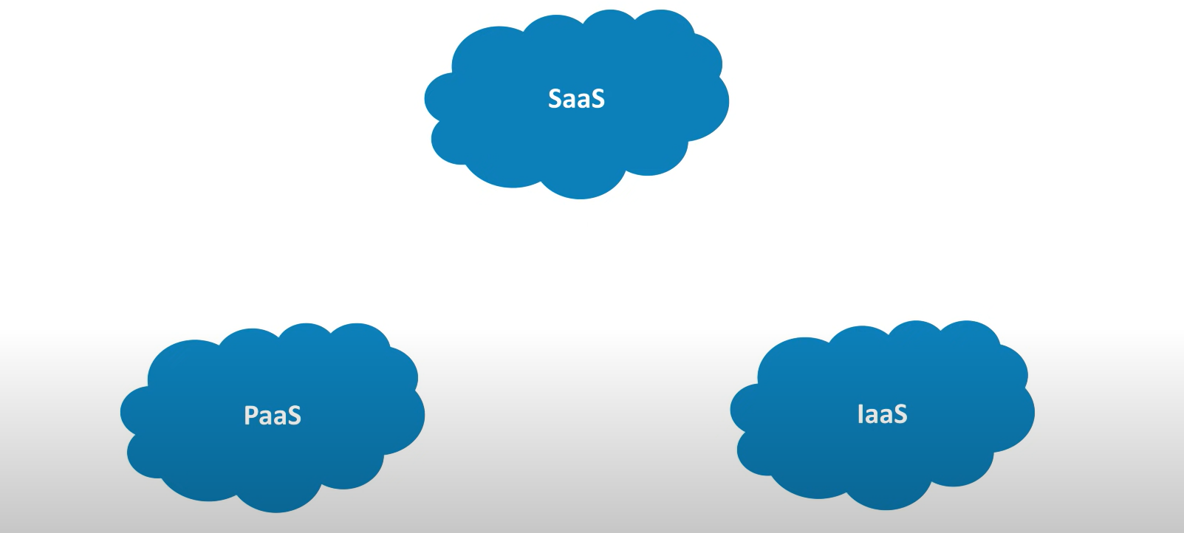
Cloud Computing Service Models

Slide 17
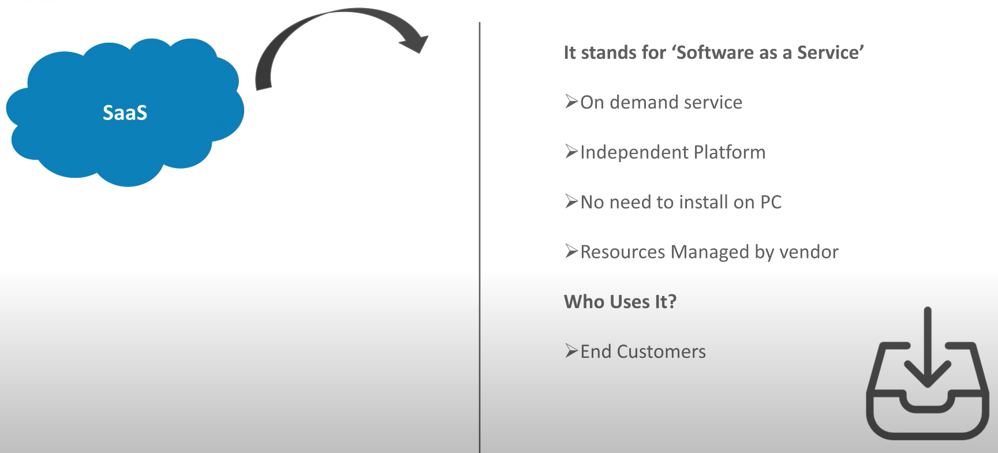
Cloud Computing Service Models

Slide 18
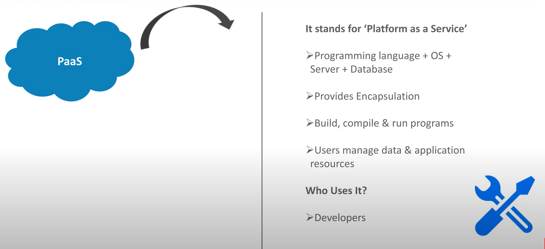
Cloud Computing Service Models

Slide 19
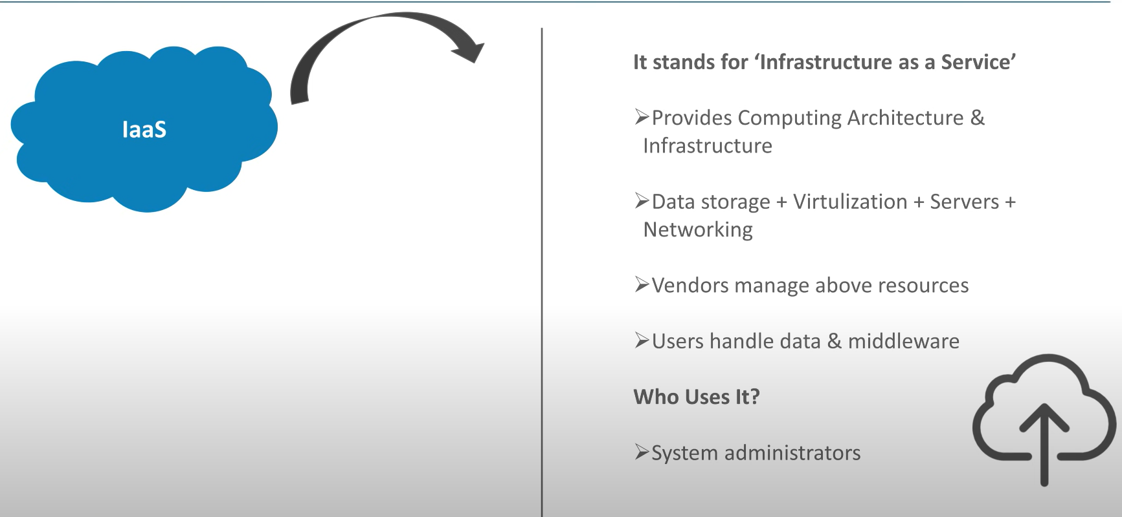
Cloud Computing Service Models

Slide 20
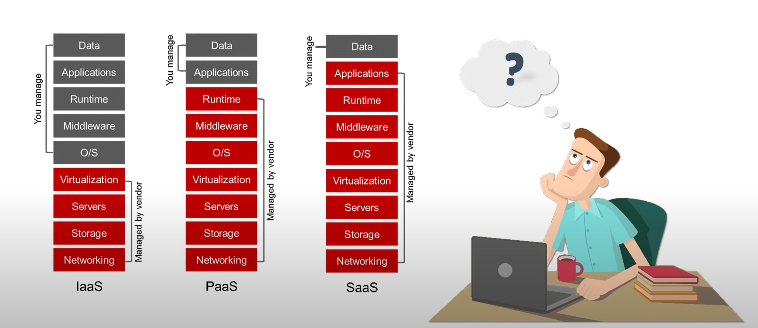
Cloud Computing Service Models

Slide 21

What is Azure?

Slide 22
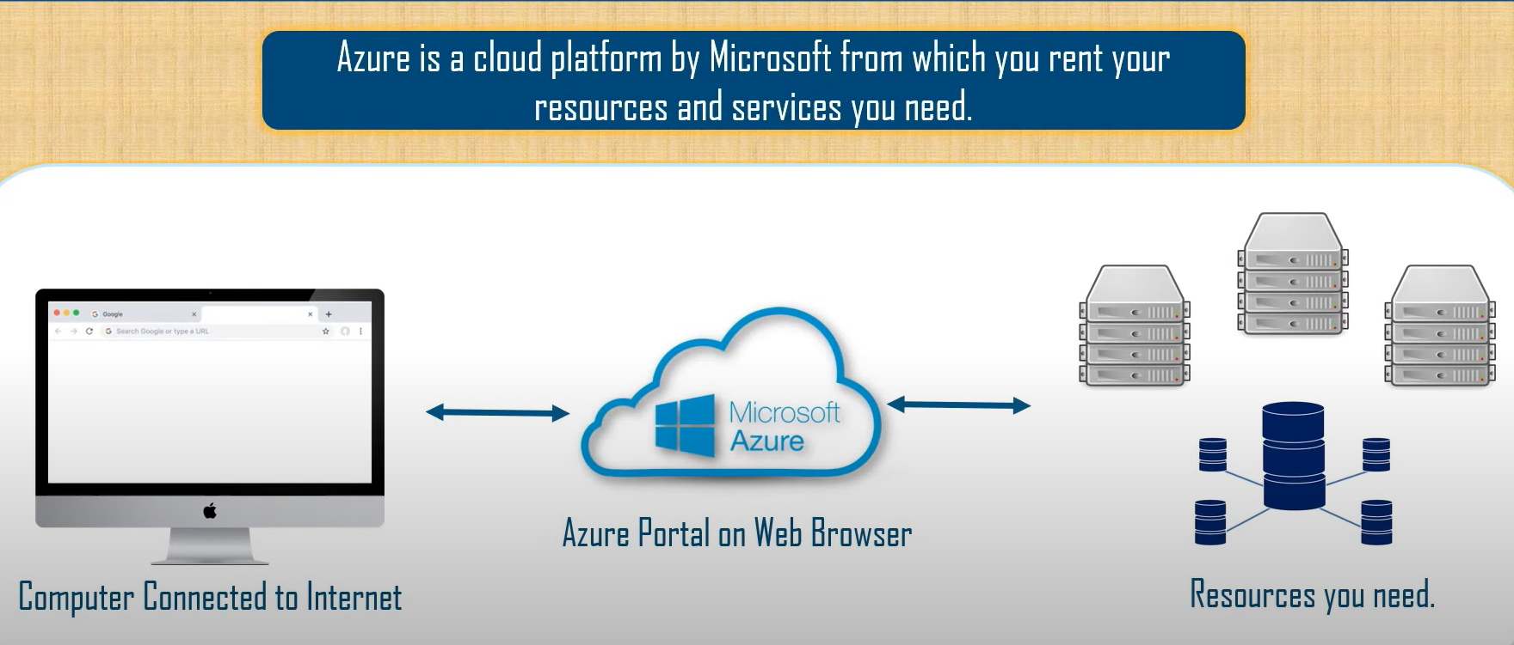
What is Azure?

Slide 23
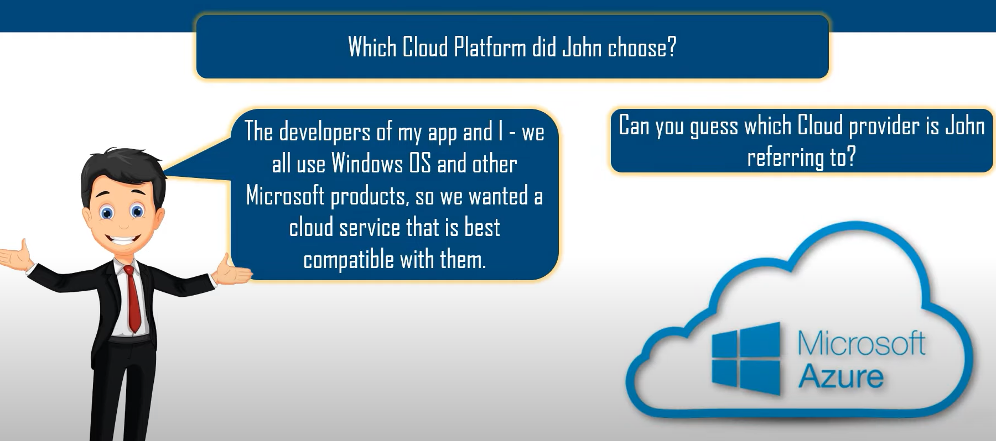
What is Azure?

Slide 24
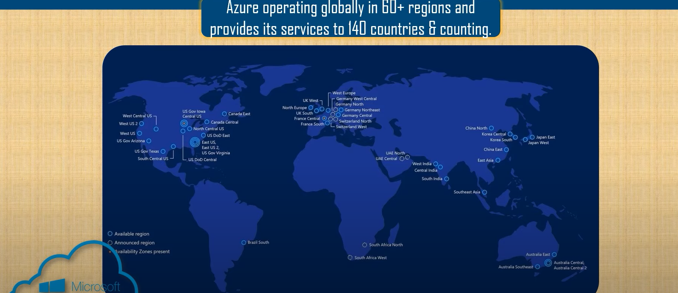
What is Azure?

Slide 25
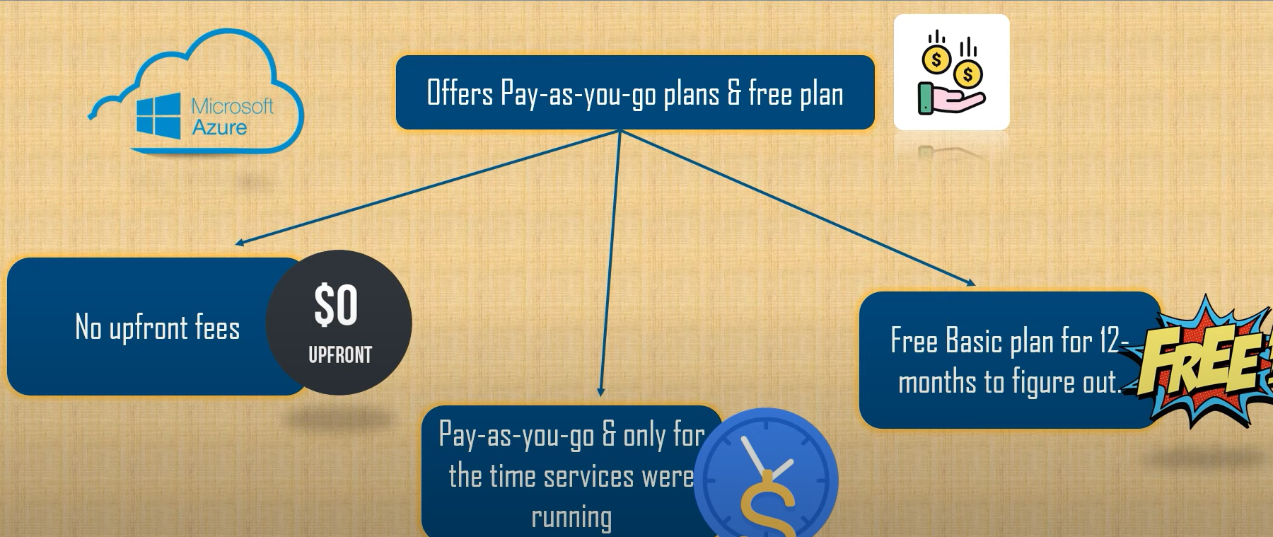
What is Azure?

Slide 26
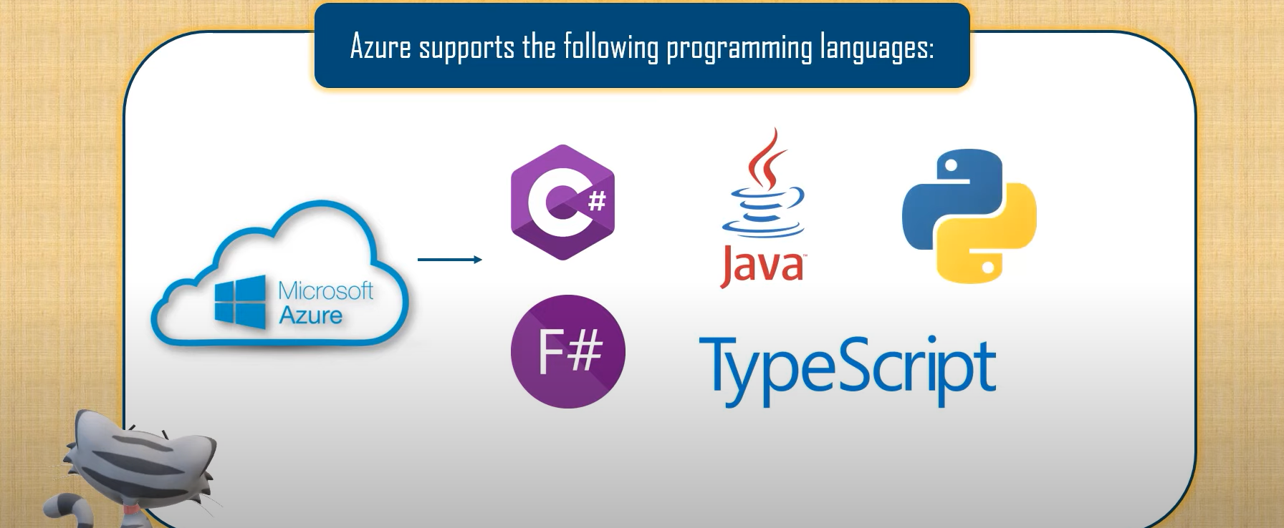
What is Azure?

